Slide 1



Stock Pitch
Northrop Grumman Corporation
(NYSE: NOC)
Overweight
Current Price: $473.20
Price Target: $697.72 (47.5% Upside)
April 2025

Slide 2
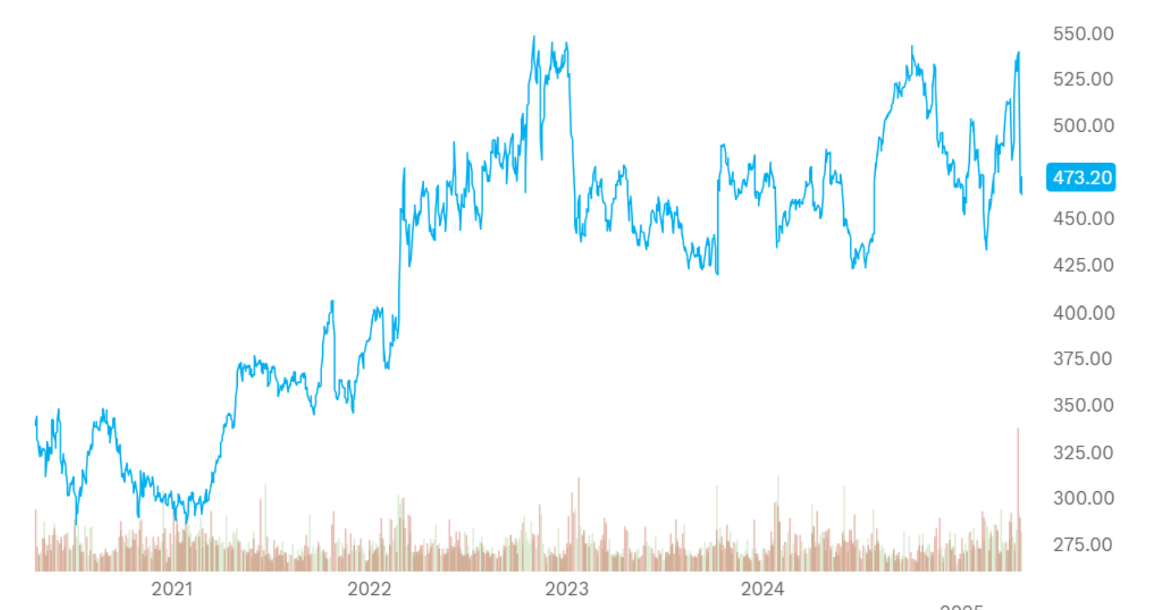
Situation Overview
Northrop Grumman Corporation
Trump: $1 Trillion
Pentagon Budget Promise
October 7
Attack on Israel
Russian Invasion of Ukraine
NOC 2025 Q1 Earnings Call
1

Slide 3
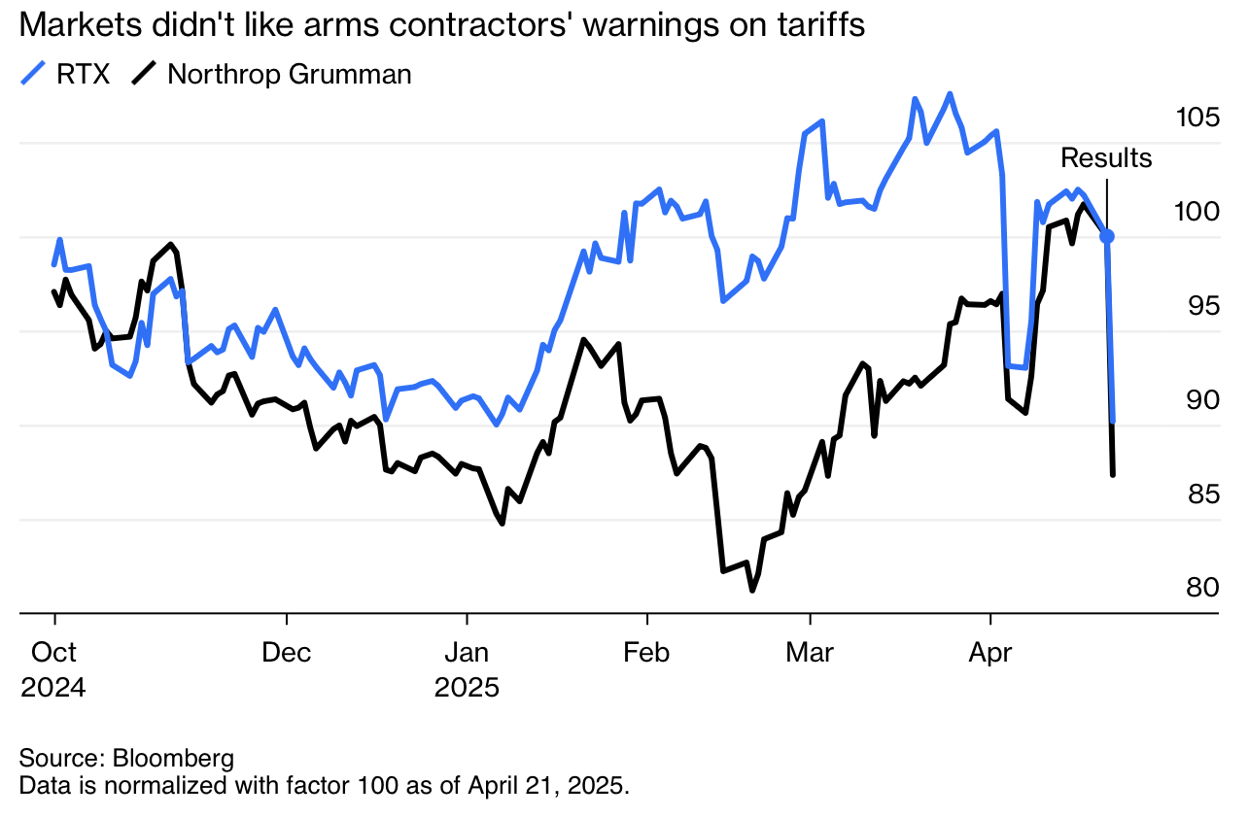
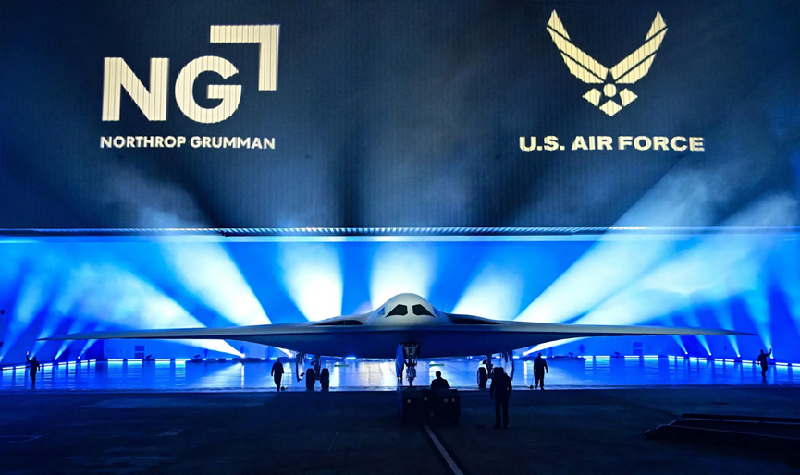
Situation Overview: Sector Volatility
Northrop Grumman Corporation
Post-earnings stock dip (~12%) following concerns around Sentinel and B-21 program costs.
Ongoing defense budget growth provides strong multi-year revenue tailwinds.
Valuation reset across the defense sector (peers like Lockheed, RTX also declined).
Strategic priority shift toward space, autonomous systems, and nuclear modernization aligns with NOC strengths.
Why This Opportunity Exists:
The Street underrates NOC’s long-term earnings power and resilience.
  Consensus indicates flat revenues and extremely modest growth.
We believe Northrop has accelerated growth potential as many of its vital long-term contracts enter production phases and scale up.
2

Slide 4
Investment Thesis Overview
Northrop Grumman Corporation
Geopolitical Tensions Drive Global Defense Spending Growth
Critical Contractor for US Defense Programs
Leader in High-Growth Areas
Heightened international tensions (Russia-Ukraine, US-China, etc) have marked the largest defense spending increases since 2009.
NATO & APAC allies (Japan, Australia) have ramped up defense budgets, making historical military expansions.
Multiyear defense spending commitments ensure stable streams of revenue.
Current Price: $473.20
Price Target: $697.72
Implied Upside: 47.5%
Sentinel ICBM is vital to US deterrence. Northrop is the sole contractor and the program cost estimated $130B+.
B-21 Raider Stealth Bombers are the first of a new generation of bombers, ensuring Northrop is a lead contractor for future aviation.
Backlog of $91.5B as of 2024, with a book-to-bill ratio of 1.23, indicating strong future demand.
DCF Base: 697.72
Growth in Perpetuity: 710.69
Exit Multiple: 684.75
EV/EBITDA Multiple: 17.24x
Comps EV/Revenue: $587.12
Upside: 24.1%
Comps P/E Ratio: $549.22
Upside: 16.1%
Northrop is a leader in both space and autonomous systems, which are growing quickly and feature in Northrop’s backlog.
The AI boom has resulted in increased demand for autonomous defense solutions.
3

Slide 5
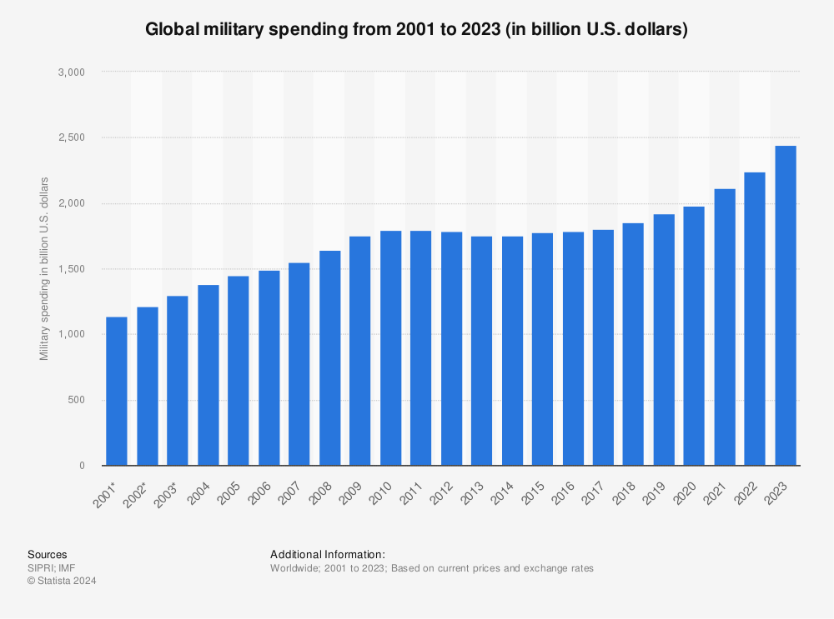
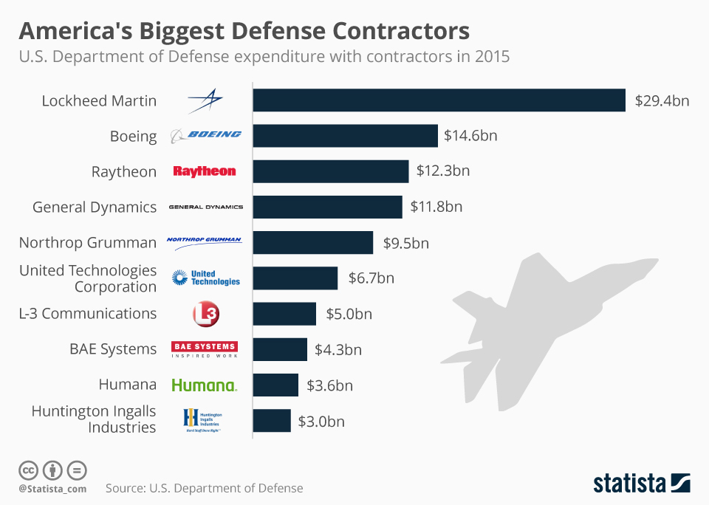
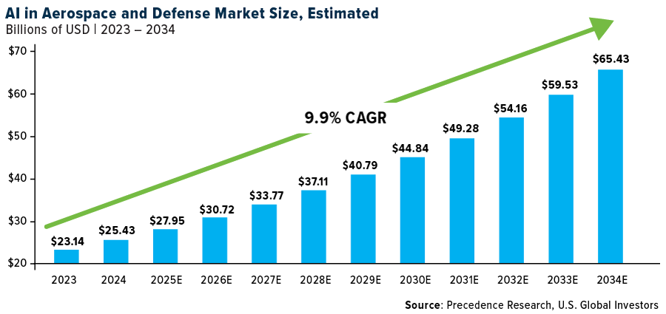
Industry Overview
Northrop Grumman Corporation
Global military spending has increased to $2.46T as of 2024, and is forecasted to grow in light of rising geopolitical tensions (US-China, Russia-Ukraine, etc). US spending remains dominant with Trump’s $1T defense budget promise.
Key growth areas include space, autonomous systems/AI, and cybersecurity fuel competition for DoD and foreign defense contracting.
Defense is highly consolidated with the top 5 firms dominating the market. High R&D costs, regulatory barriers, and security clearance requirements create massive barriers to entry, reinforcing the top-heavy market structure.
4

Slide 6
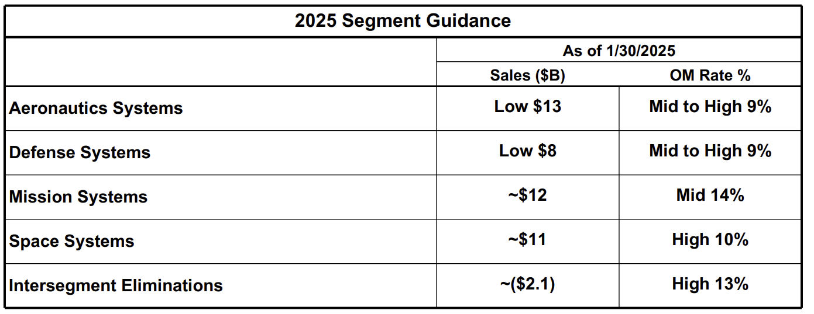
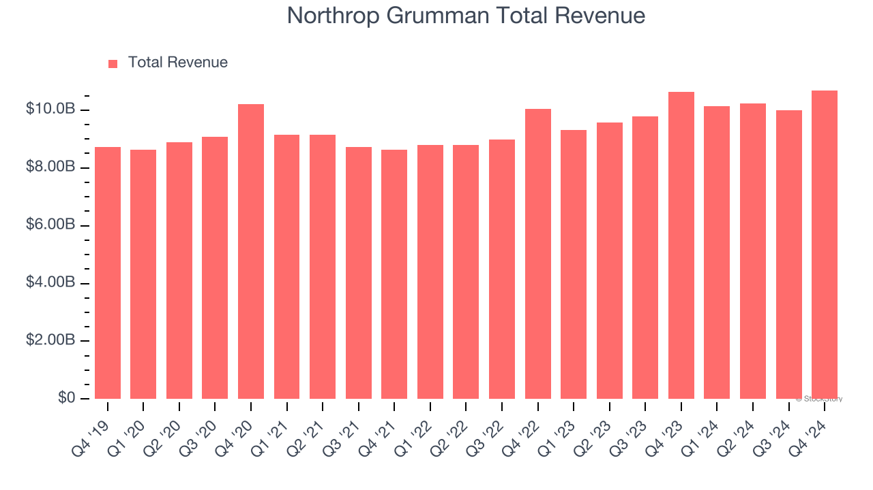
Company Overview
Northrop Grumman Corporation
Segment Overview:
Aeronautics Systems (aircrafts, including bombers/drones)
Defense Systems (missiles, training, advanced weapons)
Mission Systems (radar, sensors, cyber, etc)
Space Systems (satellites, strategic deterrence, space vehicles).
Relevant Financials:
FY2024 Total Sales: $41B (4% YoY increase)
Share Price: $473.20
Market Cap: $66.8B
FY2024 Operating Margin: 10.6% (up from 6.5 in 2023, which was down from 9.8 in 2022)
  B-21 $1.6B pre-tax charge caused the drop in 23).
5

Slide 7

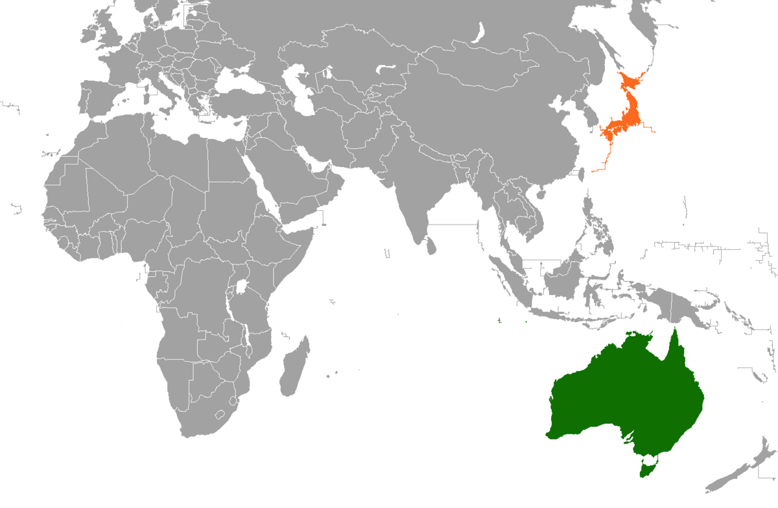
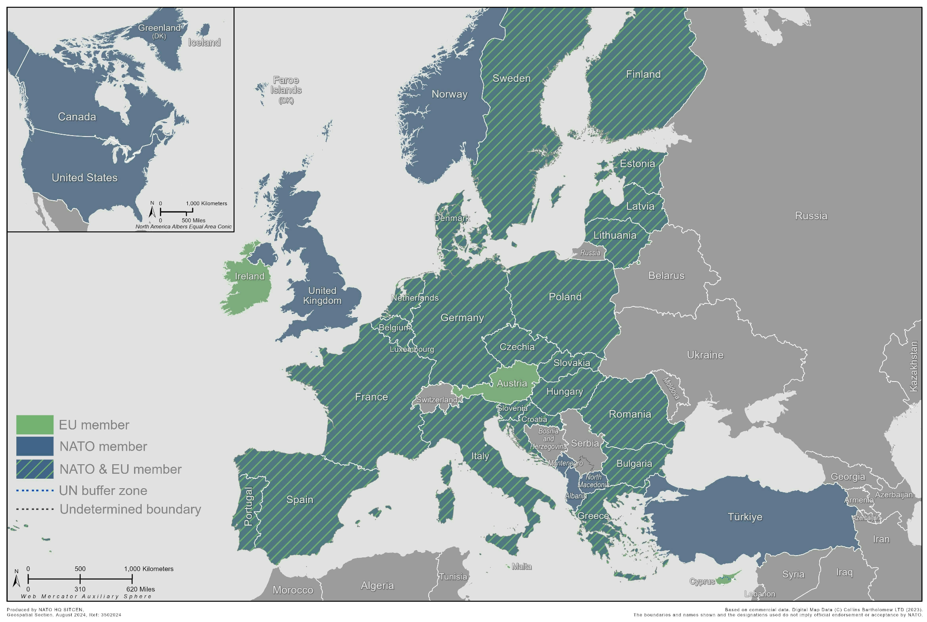
Investment Driver 1: Rising Geopolitical Tensions
Northrop Grumman Corporation
United States:
As a top 5 military contractor, Northrop is poised to capture spending growth from US-China tensions.
Access to a steady revenue stream as a result of bipartisan commitment to defense spending.
Europe:
23 NATO allies have committed to meeting the 2% of GDP defense spending goal-up from 6 in 2021.
Opportunities arising from increased European funding to Ukraine.
14% revenue is currently international.
Japan & Australia:
Due to tensions with China:
Japan aims to double its defense spending by 2027 (to ~2% GDP).
Australia committed to a 50B AUD increase in defense spending over the next decade.
Both are “focus countries” for Northrop Grumman.
6

Slide 8
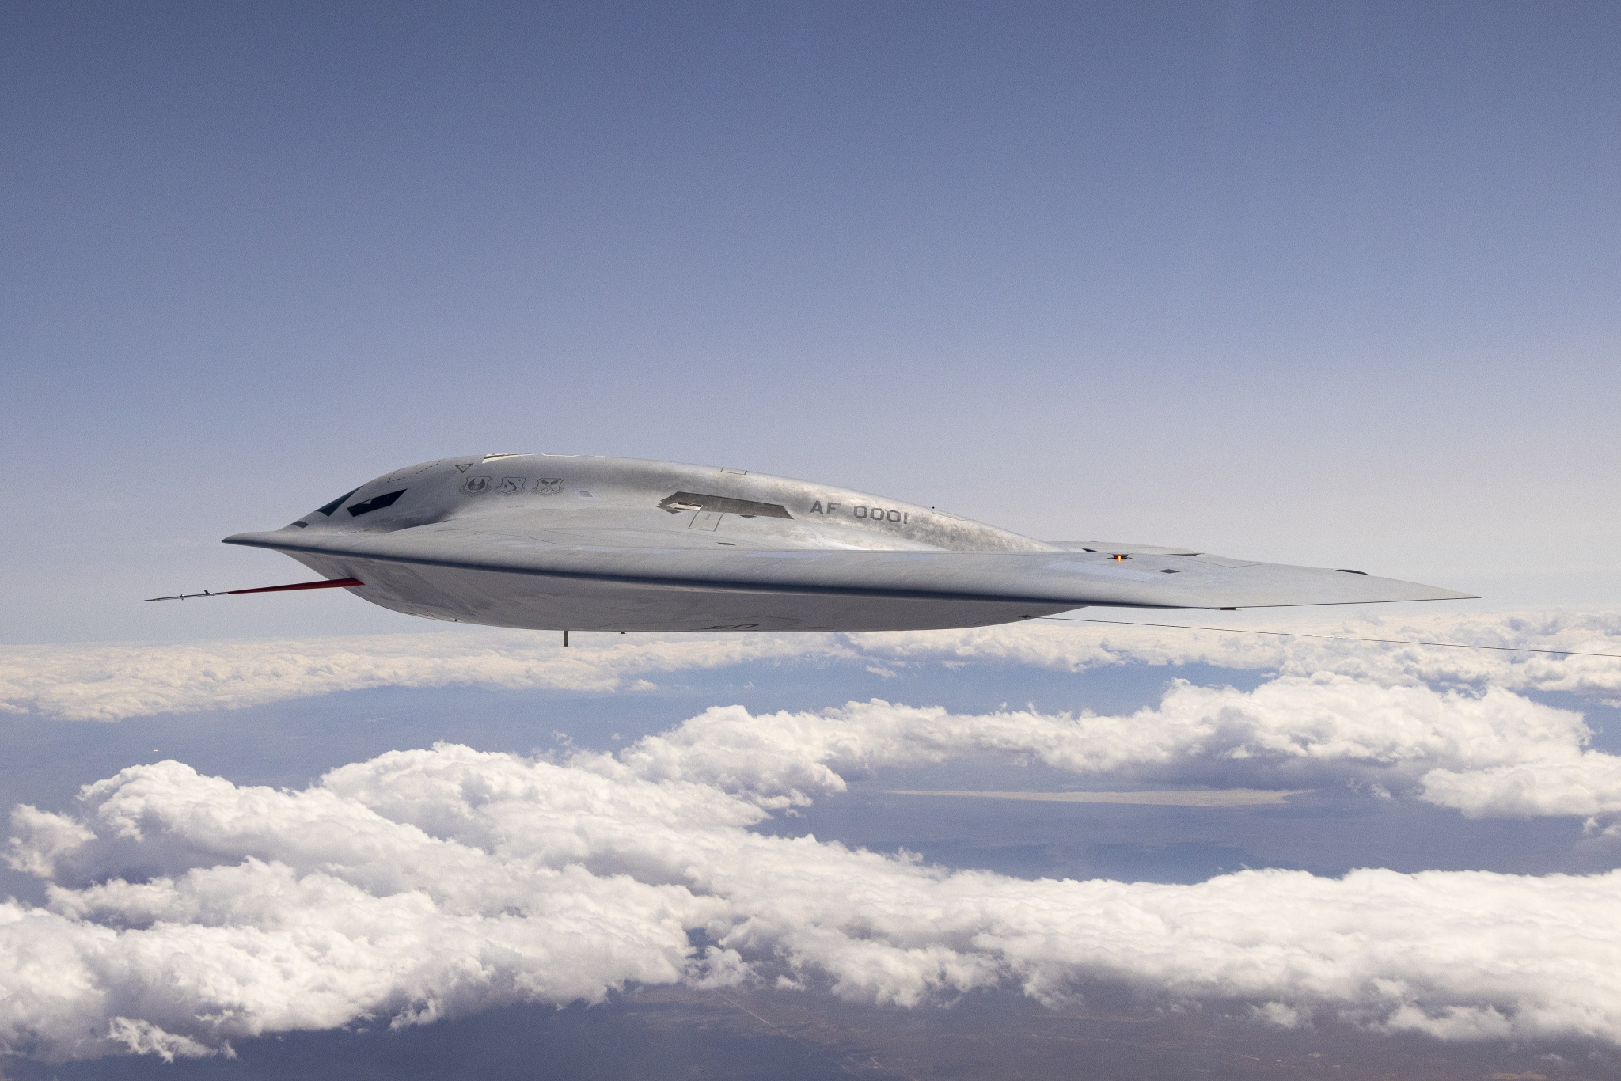
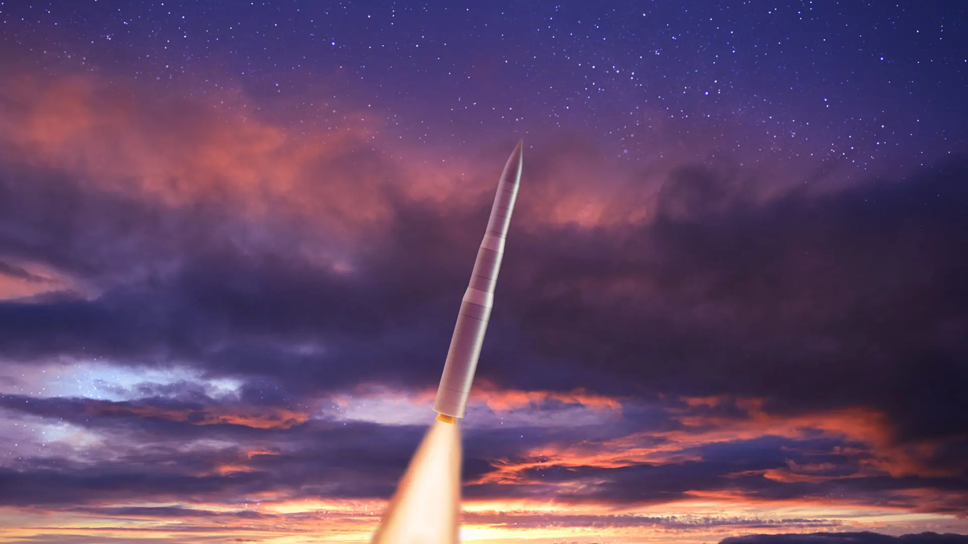
Investment Driver 2: Impending US Defense Contracts
Northrop Grumman Corporation
The US Nuclear Triad:
US Nuclear Deterrence is a three pronged system: Submarines, Strategic Bombers, and ICBMs.
Northrop is a vital contractor for both ICBMs and Bombers.
  B-21 Raider is estimated to be ~$200B program
  Sentinel ICBM is estimated to be ~$140B program.
Both programs ensure years of stable revenue backed by U.S. Department of Defense priorities.
  Nuclear modernization is considered non-negotiable by U.S. defense policy and bipartisan political consensus.
Significant Future Upside: Full-rate production on B-21 expected by 2026–2027; Sentinel full deployment into the 2030s.
Recession-resistant: 85–90% of revenue comes from long-term government contracts.
Backlog of $91.5B indicates high future demands
7

Slide 9
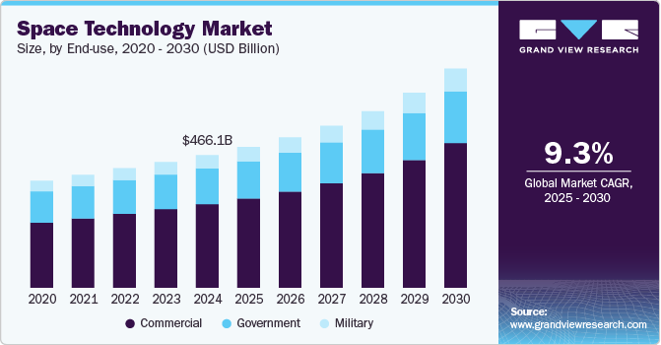
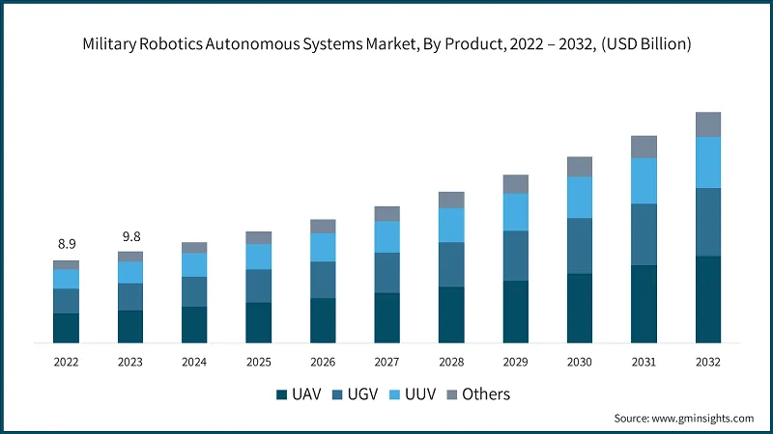
Investment Driver 3: Leading in Growth Areas
Northrop Grumman Corporation
Space Systems Growth:
NOC's Space Systems division (satellites, strategic deterrence, space vehicles) grew to become its largest segment by revenue in 2023, capitalizing on rising defense and commercial space demand. Space spending is a strategic priority for the U.S. and its allies.
Autonomous Systems and AI Integration:
Increased investment in AI-driven defense solutions (e.g., autonomous drones, surveillance systems) positions NOC as a leader in next-gen military capabilities. The global autonomous defense market is projected to grow at ~12% CAGR through 2030.
First Mover Advantage:
Early investment in high-barrier sectors (space, nuclear modernization, autonomy) protects NOC from new competitors and ensures access to premium defense contracts.
8

Slide 10
Financials I - Income Statement
Northrop Grumman Corporation
1. Revenue grew from $35.6B in FY21 to $39.3B in FY23 and then to $41.0B in FY24, reflecting a $5.4B increase over three years which coincides with the outbreak of the war in Ukraine in 2022, The uptick in revenue is likely driven by higher demand for aerospace, defense systems, and advanced weaponry — key offerings of this firm
Fiscal Year | FY 2019 | FY 2020 | FY 2021 | FY 2022 | FY 2023 | FY 2024
Revenue | 33841.00 | 36799.00 | 35667.00 | 36602.00 | 39290.00 | 41033.00
% Growth |  | 8.74% | -3.08% | 2.62% | 7.34% | 4.44%
COGS - Cost of Goods Sold | 26582.00 | 29321.00 | 28399.00 | 29128.00 | 32739.00 | 32671.00
Gross Profit | 7259.00 | 7478.00 | 7268.00 | 7474.00 | 6551.00 | 8362.00
SG&A - Selling, General & Admin Exp. | 4290.00 | 3249.00 | (227.00) | 1136.00 | 3906.00 | 2893.00
R&D | - | - | - | - | - | -
Operating Income | 2969.00 | 4229.00 | 7495.00 | 6338.00 | 2645.00 | 5469.00
Net Interest Exp. | (528.00) | (593.00) | (556.00) | (506.00) | (545.00) | (621.00)
Other Non-Operating Inc. (Exp.) | 107.00 | 92.00 | 73.00 | 4.00 | 149.00 | 168.00
EBT Excl. Unusual Items | 2548.00 | 3728.00 | 7012.00 | 5836.00 | 2249.00 | 5016.00
Gain (Loss) On Sale Of Invest + Assets + Other Unusual Items | - | - | 1926.00 | - | 97.00 | -
EBT Incl. Unusual Items | 2548.00 | 3728.00 | 8938.00 | 5836.00 | 2346.00 | 5016.00
Income Tax Expense | 300.00 | 539.00 | 1933.00 | 940.00 | 290.00 | 842.00
Net Income | 2248.00 | 3189.00 | 7005.00 | 4896.00 | 2056.00 | 4174.00
EBITDA | 4234.00 | 5496.00 | 8734.00 | 7680.00 | 3983.00 | 6839.00
Estimated R&D Expense | 953.00 | N/A | 1100.00 | 1200.00 | 1200.00 | 1100.00
2. Despite not being reported in filings, Capital IQ shows consistent R&D spending of around $1.1–1.2B annually from FY21 to FY24.
3.EBITDA nearly doubled from FY19 ($4.2B) to FY21 ($8.7B), then cooled to $3.9B in FY23 before rising again to $6.8B in FY24.
9

Slide 11
Financials II - Balance Sheet Highlights
Northrop Grumman Corporation
1. Cash & short-term investments nearly doubled from $2.2B in FY19 to $4.4B in FY24, giving the company increased financial flexibility to invest, buy back shares, or weather geopolitical shocks.
Fiscal Period Ending | FY2019 | FY2020 | FY2021 | FY2022 | FY2023 | FY2024
Cash & ST Investments | 2245.00 | 4907.00 | 3530.00 | 2577.00 | 3109.00 | 4353.00
Total Assets | 41089.00 | 44469.00 | 42579.00 | 43755.00 | 46544.00 | 49359.00
Long-Term Debt | 12770.00 | 14261.00 | 12777.00 | 11805.00 | 13786.00 | 14692.00
Total Liabilities | 32270.00 | 33890.00 | 29653.00 | 28443.00 | 31749.00 | 33069.00
Total Equity | 8819.00 | 10579.00 | 12926.00 | 15312.00 | 14795.00 | 15290.00
2. Total assets increased from $41.1B to $49.4B over five years, while long-term debt rose by only $1.9B, showing a conservative approach to debt-funded growth.
3. Total equity grew by 73%, from $8.8B in FY19 to $15.3B in FY24, supported by retained earnings and limited equity dilution — a strong signal of shareholder value creation.
10

Slide 12
Financials III - Cash Flow Highlights
Northrop Grumman Corporation
1. Cash from operations grew steadily from $2.9B in FY22 to $4.4B in FY24, despite fluctuations in net income.
Fiscal Period Ending | FY 2019 | FY 2020 | FY 2021 | FY 2022 | FY 2023 | FY 2024
Net Income | 2248.00 | 3189.00 | 7005.00 | 4896.00 | 2056.00 | 4174.00
Cash from Ops. | 4297.00 | 4305.00 | 3567.00 | 2901.00 | 3875.00 | 4388.00
Capital Expenditure | (1264.00) | (1420.00) | (1415.00) | (1435.00) | (1775.00) | (1767.00)
Cash from Investing | (1207.00) | (1211.00) | 2058.00 | (1241.00) | (1582.00) | (1749.00)
Total Dividends Paid | (880.00) | (953.00) | (983.00) | (1052.00) | (1116.00) | (1186.00)
Cash from Financing | (2424.00) | (432.00) | (7002.00) | (2613.00) | (1761.00) | (1395.00)
Net Change in Cash | 666.00 | 2662.00 | (1377.00) | (953.00) | 532.00 | 1244.00
2. CapEx remained above $1.7B annually from FY22 to FY24, supporting long-term defense innovation and production capacity.
3. Despite fluctuations in net income and high capital spending, the company consistently paid dividends, increasing from $880M in FY19 to $1.19B in FY24.
11

Slide 13
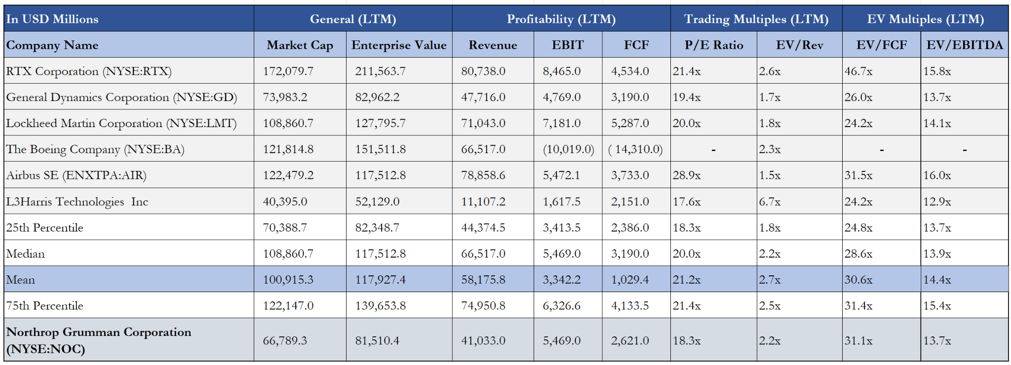
Comparable Companies Analysis
Northrop Grumman Corporation
At a chosen EV/Revenue (LTM) 2.7x multiple, NOC’s implied share price is roughly $587.12, reflecting an upside of 24.1%.
2) Why EV/Rev is used:
We used EV/Revenue as the primary valuation metric because competitors like Boeing’s negative operating income makes multiples like EV/FCF and EV/EBITDA unreliable or unusable.
EV/Revenue also makes it easier to compare these companies because it focuses on their ability to generate revenue, without getting distorted by short-term swings in profitability from things like restructuring costs or one-off issues (e.g. R&D expenses, production halts).
1) Why Airbus is included in Comparables :
Though it is based in Europe (outside the US), Airbus is included because it is a significant competitor in the aerospace market and a significant player in global defense contracting, and we project global demand for defense to rise, making it critical for understanding industry positioning.
12

Slide 14
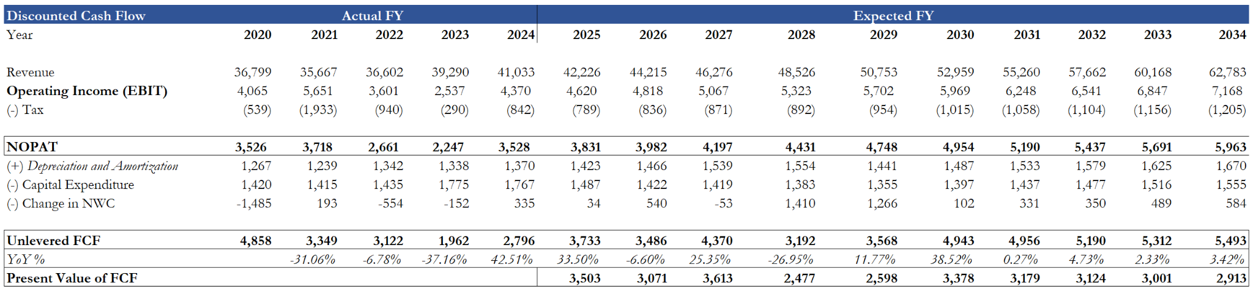
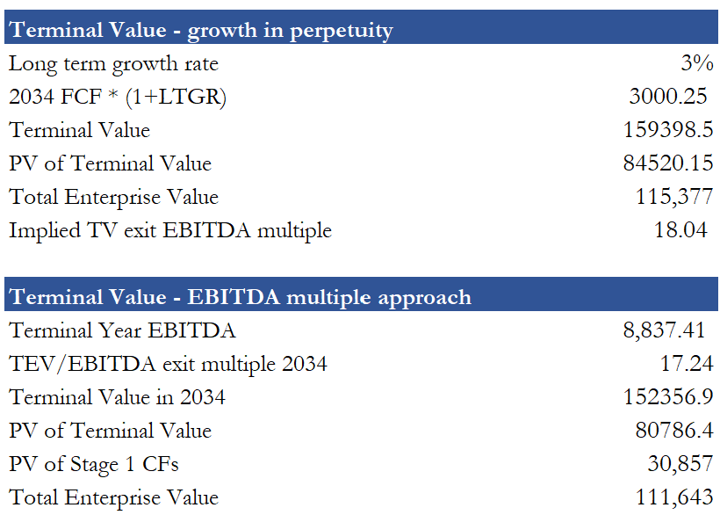
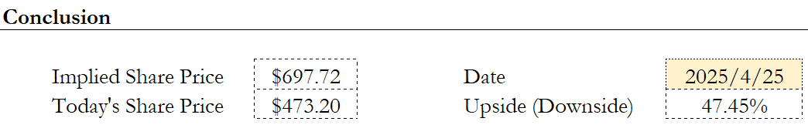
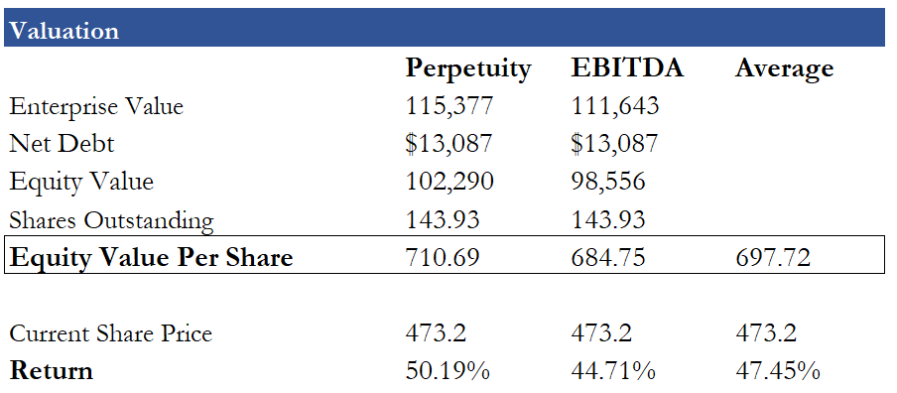
Discounted Cash Flow Model
Northrop Grumman Corporation
We project NOC’s revenue and operating income to grow faster than the market average because it is the synthesis of these factors:
- US Defense Budget ~4% annual increase (2015-25)
- Rising geopolitical tensions
- Impending US Defense Contracts
We anticipate NOC's operating income and margins to similarly grow as these defense contracts are executed and military systems are manufactured, given the consistency of NOC’s weapons portfolio.
If revenues are as expected, NOC’s implied share value is close to $697.72, implying an upside of 47.45%.
13

Slide 15
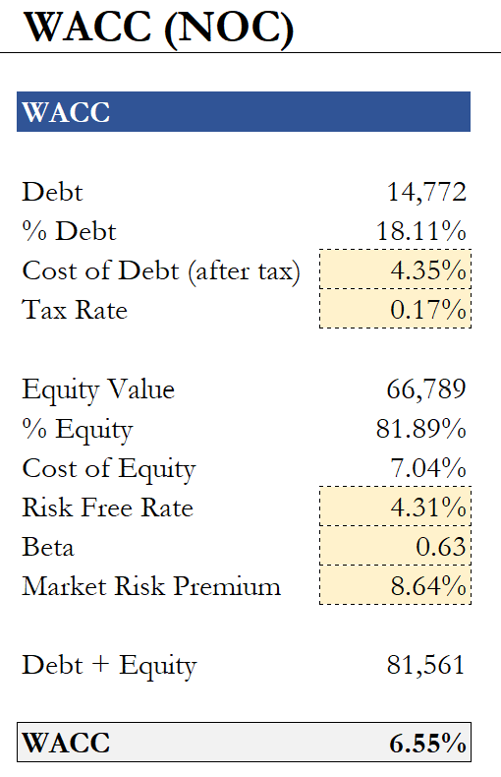
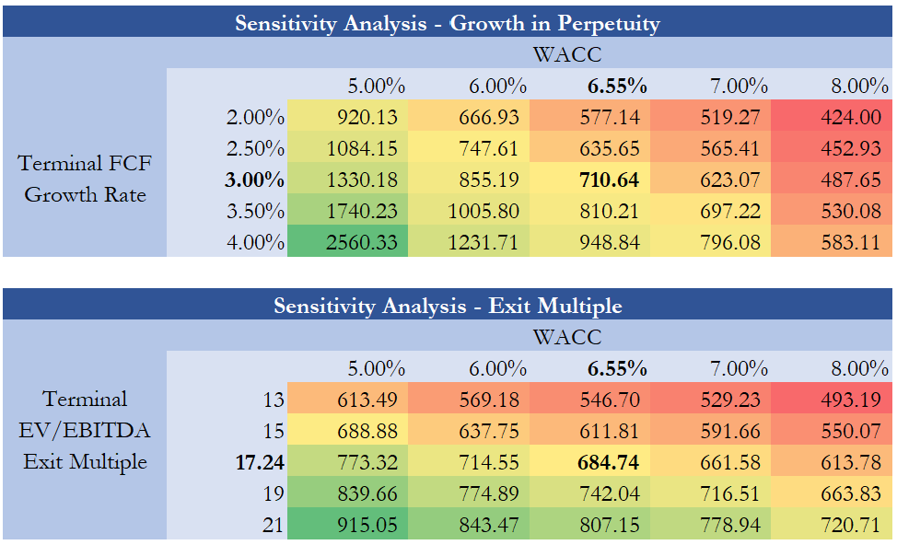
WACC and Sensitivity Analysis
Northrop Grumman Corporation
14

